Slide 1
Microsoft Backstage View
Name
Institution of Affiliation

Slide 2
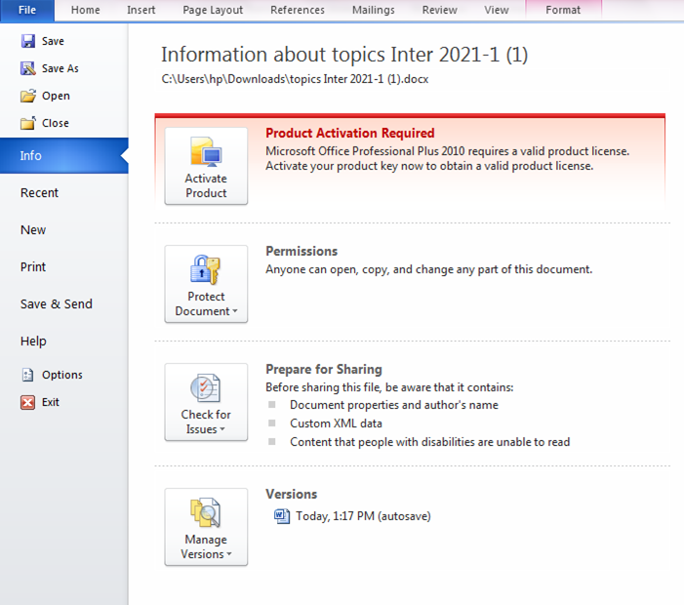
Microsoft Backstage View

Slide 3
Backstage View
Backstage view helps in navigating through Microsoft office.
To access backstage view click on the file tab and backstage view will display.
This tool offers a variety of commands that helps a user navigate the Microsoft office easily.
Backstage view offers a variety of file management tasks and customize a file to meet the needs of the user.

Slide 4
Info Tab
Info tab provides the user with the autonomy to dictate which files should be accessed and which ones cannot be accessed through password protection.
The user is also allowed to modify the properties of a document.

Slide 5
Compatibility Mode
This functions provides limitations when an older version of a document is viewed.
For full accessibility to be granted, a document should be saved as a .docx File for word 2010.
Older versions can be saved as .doc file.

Slide 6
Protecting a Document
Document protection is a function that enable a user to use passwords to protect their documents and prevent other people from making modifications in their files.
When a password is embedded in a document the user has to remember since Microsoft cannot remember.

Slide 7
Save/ Save As
Save function is used by the user to save changes that have been made to a document.
Save as function is used to save a file using a different file name or file format.

Slide 8
File Extensions
.docx: is used in Word 2007, 2010, 2013
.doc: is use in Word 97-2003
.dotx: Word template
.rtf: Rich Text Format for opening the file in text editors with limited formatting
.txt: Plain Text Format allows a user to open the file in text editors with NO FORMATTING
.pdf: Portable Document Format allows a user to view the file in Adobe Reader

Slide 9
Close Function
This function is used by the user to close the word document that is open by the user.
However, this does not close the word program but only the file and waits for the user to add another document.

Slide 10
Help Function
The help function is left on the top right corner of the window.
The help command appears like a question mark.
Help function provides the user with help to make any changes or seek clarification on some functions.

Slide 11
Options, New, Recent Functions
Options function allows the user to access various options relating to the word document.
New function enables the user to open a new document.
Recent function allows the user to easily access newly opened documents.

Slide 12
Exit Backstage View
This is a command that allows the user to close the document and exit from the word program. To do this the user simply clicks exit.

Slide 13
References
John Wiley & Sons, Inc. (2012). Microsoft
Official Academic Course Microsoft
Word 2010, Exam 77-883.

